Slide 1

`
RFM Program
CB’s Assessors Training Deck, Standard Version 2

Slide 2
RFM Training Deck Structure
CSC’s RFM Program
Certification
The RFM Standard V 2
RFM Assessment and Certification Process
Scoring Process and Examples
Unique Updates from Version 2
V2 Metrics and Thresholds
Assessment Test
Data Deficient Framework

Slide 3
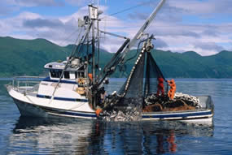
The Certified Seafood Collaborative and the RFM Standard
In order to provide credible verification of Responsible Fisheries Management in Alaska, the Certified Seafood Collaborative (CSC) has been offering a choice in certification since 2010. The RFM program was formerly owned by the Alaska Seafood Marketing Institute

Slide 4
The RFM Standard Remit
The RFM Program entails at its core:
Responsible Fisheries Management, including enhancement practices (but excluding full cycle aquaculture), up to the point of landing, with the main objective being the biological sustainability of the “stock under consideration”, with consideration for conservation, biodiversity and ecosystem integrity; and due regard to social responsibility and the economic viability of the fishery.

Slide 5
RFM Certified Fisheries
The RFM Program has certified 8 fisheries to date in this order starting from 2011:
Alaska Salmon,
AK Pacific Halibut,
AK Sablefish (black cod),
AK Walleye Pollock,
Bering Sea and Aleutian Islands (BSAI) Crab (4 species),
AK Pacific Cod,
The Flatfish complex in the BSAI and Gulf of Alaska (GOA).
Atka Mackerel and Rockfish

Slide 6
Certification

Slide 7
CSC RFM Key Program Stats
Certification Bodies: SAIG, DNV Global and SCS
ISO 17065 Accreditation Bodies: ANSI and INAB
International Benchmarks: GSSI Since 2016
Certificates: 8 fisheries, approx. 80 CoC
RFM Program ownership and management: Certified Seafood Collaborative
Current Standard: V1.3 is the outgoing standard. All new fisheries assessment and re-certification to be assessed under V2.0 since May 1st 2018. This is first complete reissuance of the RFM Standard since the program’s inception in 2010.
Current Assessment/Certification Procedure: One and the same for the 2 standards but 2 QPs posted on the ASMI website.

Slide 8
The RFM Standard V1.3 & V2

Slide 9
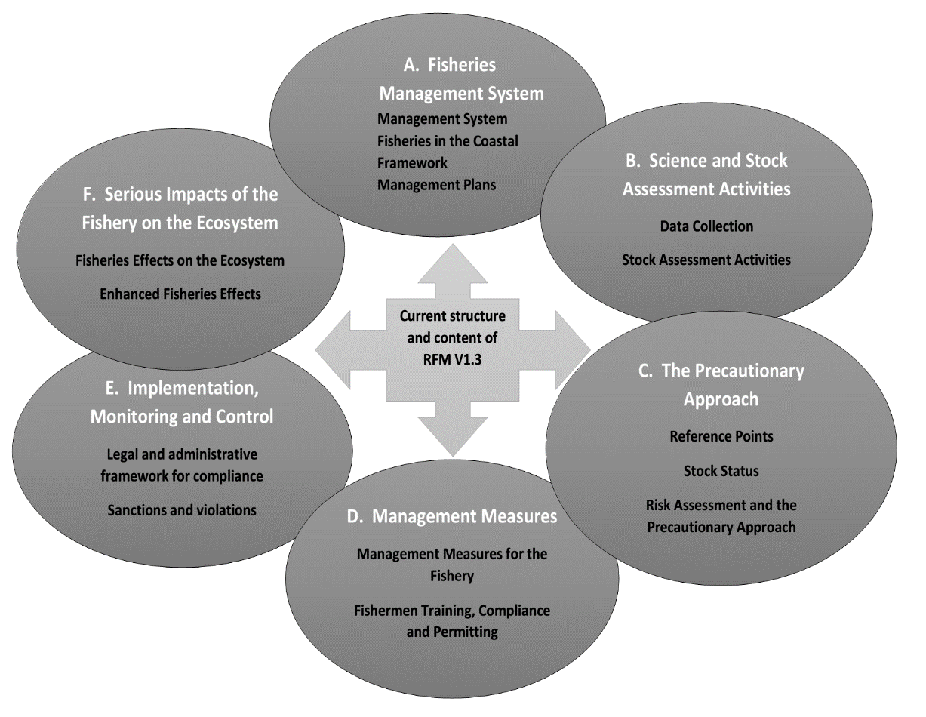
RFM Version 1.3 Structure Diagram

Slide 10
RFM Version 1.3 to Version 2.0
Cumulative Effects of Fisheries
Metrics (stock status, bycatch, habitat)
Improve and Restructure Ecosystem Effects Section
Housekeeping changes (cleanup and restructure)
GSSI Standard Essential Elements
Significant Stakeholder Input
RFM Standard Version 1.3

Slide 11
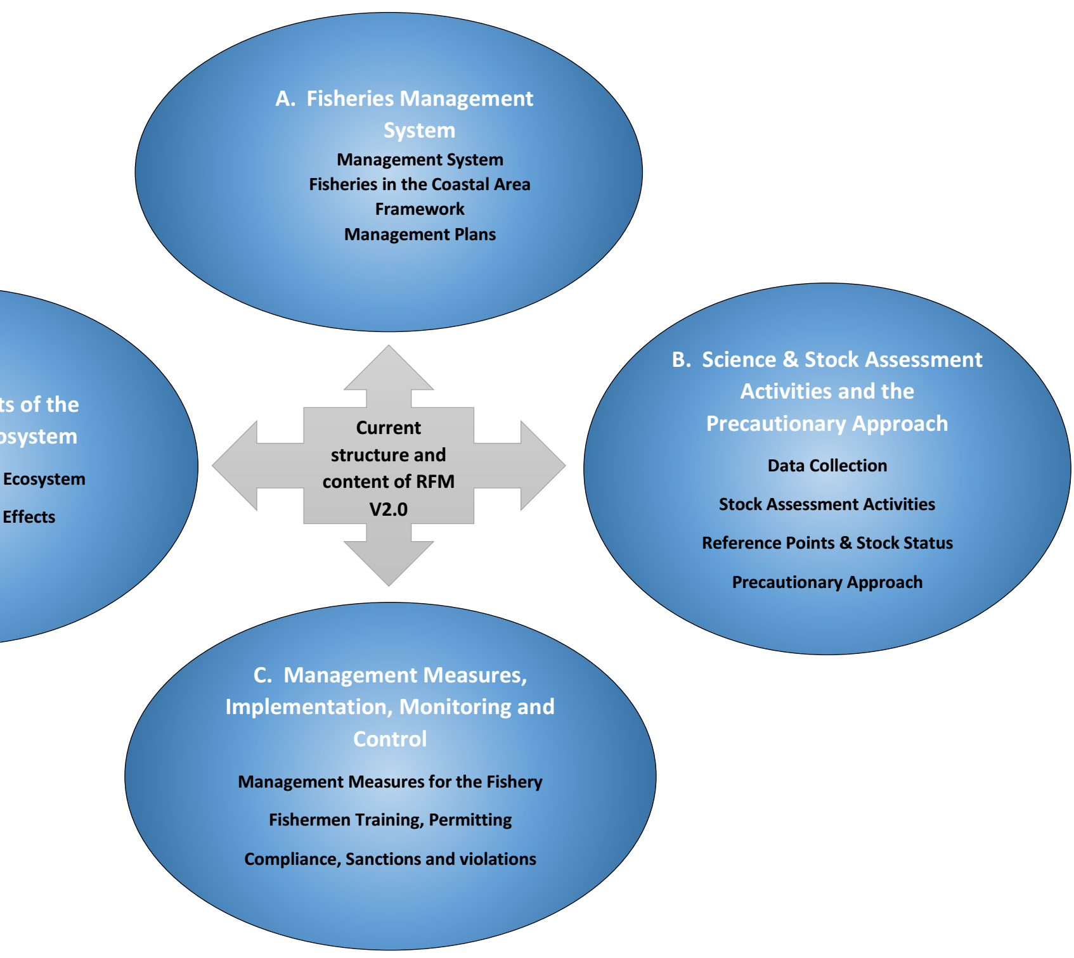
RFM V 2
Structure

Slide 12
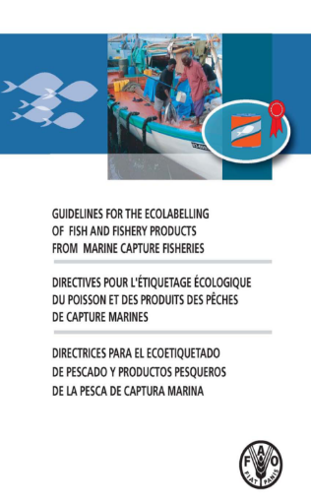
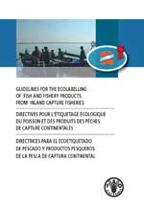
RFM Version 2 Standard
+
AK Responsible Fisheries Management
Conformance Criteria
A Tool for Voluntary Use in Markets for
Products of Marine Capture Fisheries that wish to demonstrate
Responsible Fisheries Management
+ GSSI and due standard updates
=

Slide 13
FAO Code of Conduct for Responsible Fisheries
Fisheries specific articles 6, 7, 8, 10, 12 of the Code of Conduct for Responsible Fisheries included in the RFM Standard are:
Art. 6: General Principles
Art. 7: Fisheries Management
Art. 8: Fishing Operations
Art. 10: Coastal Area Management
Art. 12: Fisheries Research
Articles dealing with post Harvest Practices and Full Cycle Aquaculture are not included in the RFM Standard (i.e. N/A).

Slide 14
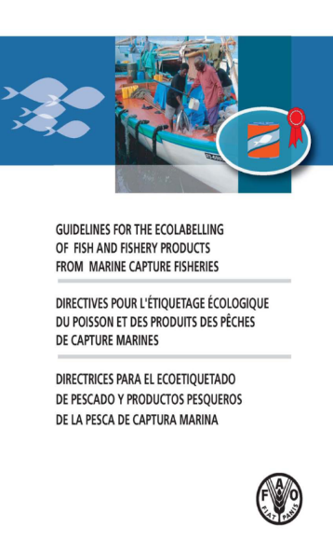
FAO Eco label Guidelines/Marine
The Guidelines for the Ecolabelling of Fish and Fishery Products from Marine Capture Fisheries are of a voluntary nature and are applicable to ecolabelling schemes that are designed to certify and promote labels for products from well-managed marine capture fisheries and focus on issues related to the sustainable use of fisheries resources.
The guidelines refer to principles, general considerations, terms and definitions, minimum substantive requirements and criteria, and procedural and institutional aspects of ecolabelling of fish and fishery products from marine capture fisheries.
All minimum substantive criteria (i.e. fisheries technical requirements) are part of the RFM Conformance Criteria.

Slide 15
FAO Eco label Guidelines/Inland
The Guidelines for the Ecolabelling of Fish and Fishery Products from Inland Capture Fisheries are of a voluntary nature and are really an updated version of the FAO Guidelines for the Ecolabelling of Fish and Fishery Products from Marine Capture Fisheries.
Salient points about the FAO Inland fisheries guidelines include the additional requirements for enhanced fisheries. These requirements fully apply to the Alaska salmon commercial fisheries.
All minimum substantive criteria (i.e. fisheries technical requirements) are part of the RFM Conformance Criteria.

Slide 16
FAO Based Conformance Criteria V 2,
Key Sections of the Standard
A The Fishery Management System
B Science and Stock Assessment Activities, and the Precautionary Approach
C Management Measures, Implementation, Monitoring and Control
D Serious Impacts of the Fishery on the Ecosystem

Slide 17
FAO Based Conformance Criteria V 2,
Fundamental Clauses
These sections are in turn divided in 13 Fundamental Clauses, each made up of its supporting criteria.

Slide 18
A. The Fisheries Management System
Fundamental Clauses
1. There shall be a structured and legally mandated management system based upon and respecting international, national, and local fishery laws, for the responsible utilization of the stock under consideration and conservation of the marine environment.
2. Management organizations shall participate in coastal area management institutional frameworks, decision-making processes and activities related to the fishery and its users, supporting sustainable and integrated resource use, and conflict avoidance.
3. Management objectives shall be implemented through management rules and actions formulated in a plan or other framework.

Slide 19
B. Science and Stock Assessment Activities, and the Precautionary Approach
Fundamental Clauses
4. There shall be effective fishery data (dependent and independent) collection and analysis systems for stock management purposes.
5. There shall be regular stock assessment activities appropriate for the fishery, its range, the species biology, and the ecosystem, undertaken in accordance with acknowledged scientific standards to support its optimum utilization.
6. The current state of the stock shall be defined in relation to reference points, relevant proxies, or verifiable substitutes that allow effective management objectives and targets to be set. Remedial actions shall be available and taken where reference points or other suitable proxies are approached or exceeded.
7. Management actions and measures for the conservation of stock and the aquatic environment shall be based on the precautionary approach. Where information is deficient a suitable method using risk assessment shall be adopted to take into account uncertainty.

Slide 20
C. Management Measures, Implementation, Monitoring and Control
Fundamental Clauses
8. Management shall adopt and implement effective management measures designed to maintain stocks at levels capable of producing maximum sustainable yields, including harvest control rules and technical measures applicable to sustainable utilization of the fishery, and based upon verifiable evidence and advice from available scientific and objective, traditional sources.
9. Fishing operations shall be carried out by fishers with appropriate standards of competence in accordance with international standards and guidelines and regulations.
10. An effective legal and administrative framework shall be established and compliance ensured, through effective mechanisms for monitoring, surveillance, control, and enforcement for all fishing activities within the jurisdiction.
11. There shall be a framework for sanctions for violations and illegal activities of adequate severity to support compliance and discourage violations.

Slide 21
D. Serious Impacts of the Fishery on the Ecosystem
Fundamental Clauses
12. Considerations of fishery interactions and effects on the ecosystem shall be based on best available science, local knowledge where it can be objectively verified, and a risk-based management approach for determining most probable adverse impacts. Adverse impacts on the fishery on the ecosystem shall be appropriately assessed and effectively addressed.
13. Where fisheries enhancement is utilized, environmental assessment and monitoring shall consider genetic diversity and ecosystem integrity.

Slide 22
RFM Conformance Criteria V 2,
Supporting Clauses
Each of the 13 Fundamental Clauses are in turn supported by supporting clauses.
Fisheries Standard | No. of clauses
A. The Fishery Management System | 30
B. Science & Stock Assessment Activities, & the Precautionary Approach | 30
C. Management Measures, Implementation, Monitoring and Control | 30
D. Serious Impacts of the Fishery on the Ecosystem | 35
Total number of supporting clause for Categories A-D | 125

Slide 23

Questions?

Slide 24
Assessment and Certification Process

Slide 25
Assessment Process Flowchart
Initiation
Validation Report (i.e. pre-assess)
Full Assessment Stage
Assessment Plan
Site visits
Desktop review and validation report
Reviewer selection
Peer Review
Independent Certification Committee Decision
Determination
Assessment Report
External Peer Review
Site visits (optional)
Preliminary review of information
Application
Decide UoC
Scoring
Responses
30 days public comment
NCs and Corrective Action
Stakeholder registration to allow comment at PR Stage

Slide 26
V1.3 and V2.0 Assessment and Certification Process
The certification process of client fisheries wishing to be assessed against the RFM Version 2.0 standard follows a similar process to fisheries certified to RFM Version 1.3 and will remain in full compliance with ISO 17065 accreditation requirements for the operation of a certification program.
But note there is 1 QP posted for each of the 2 Standards

Slide 27
Assessment Start -Review Preliminary Info and Propose Unit of Certification
The UoC incudes:
Defined species
Defined geographic range
Defined management area (or sub area)
Defined gear types
Defined management systems (organizations)
Applicant representing the fishery unit

Slide 28

Stakeholder Registration
Stakeholders which formally register with the CB at the notification /consultation stage can take part in the public comment stage, later on in the process.
The registration process lasts 30 days.

Slide 29
Validation Stage
Function – to complete an initial fishery assessment, identify potential gas to certification and provide recommendation to (or not to) proceed for full assessment. (Equivalent to an MSC pre-assessment)
Only Fundamental Clauses are assessed during validation assessments. A Full Assessment, on the other hand, provides evidence for all the supporting clauses.
Site visits optional, as/if required.
Result - Produce Assessment Validation Report and recommendation to/not to progress fishery to full assessment.

Slide 30
Full Assessment Stage
  Form Assessment Plan for outstanding information requirements, potential issues, assignment of sections among Team members, plan site visit, and overall assessment timeline.
  Report against the RFM V 2 Supporting Clauses
  Validation and Surveillance Report assess only against V 2 Fundamental Clauses.
  Once draft report is complete, conduct scoring through assessment team meetings (in person or through skype/conference call).

Slide 31
Information used for Full Assessment reporting
The Assessment Team carries out a desk top reviews of all relevant, scientific/objective literature, management plans, reports and other relevant information.
Everything must be accurately referenced within the report to allow for later review.

Slide 32
Answering correctly the RFM Full Assessment Requirements
The evidence provided must answer fully the requirement of each SUPPORTING clause. The evidence must be concise (wherever possible) and fully referenced.
Each assessor‘s evidence is cross examined among assessors.
Comments and requests for clarification are sent to the client.
The CB shall direct assessors in terms of quality, quantity and appropriateness of information to maintain consistency across reports and fisheries.
Confirm the validity of the information through Site Visit Verification.
Assessor shall follow the prescribed reporting format (i.e. Full Assessment Report Template) which the CB provides.

Slide 33
Site Visits and stakeholders
The assessment should include an on site visit and meet with available stakeholders:
  Client
  Competent Management Authority
  Enforcement Authorities
  Fishery Associations or representative groups
  Fishery Vessel owners / Fish Processors
  Any other organizations forming part of management processes
  NGOs
  Other stakeholders

Slide 34
Let’s recap..
How long is the initial Stakeholder Registration period for?
What is the Validation Assessment?
What Clauses are assessed during Full Assessment?

Slide 35
Scoring Process

Slide 36
Scoring Framework
Critical Non-Conformance.
Major Non-Conformance level.
Minor Non-Conformance level.
Full Conformance.

Slide 37
Scoring Framework explained
Critical Non-Conformance
Information/evidence is completely absent or contradictive to demonstrate conformance to a clause. In these cases, a critical non-conformance is assigned. A critical non-conformance will stop the assessment (applicant will not reach the next stage towards certification, the Peer Review stage), unless the applicant (and collaborating fisheries management organization) is able to provide information/evidence that demonstrates higher conformance of the fishery than initially assessed.

Slide 38
Scoring Framework
Major Non-Conformance
Information/evidence is limited to demonstrate conformance to a clause. In these cases, a major improvement is needed to achieve full conformance. If more than one major non-conformances is found in any of the Key Components (A-D for V2), assessment stops (applicant will not reach the next stage towards certification, the Peer Review stage) until evidence is made available to show a better conformity level

Slide 39
Scoring Framework
Minor Non-Conformance
Information/evidence is broadly available to demonstrate conformance to a clause although there are limited gaps in information that, if available, could clarify aspects of conformance and allow the assessment team to assign a higher conformance level. If more than three minor non-conformances are found in any of the Key Components (A-D), assessment stops (applicant will not reach the next stage towards certification, the Peer Review stage) until evidence is made available to show a better conformity level

Slide 40
Scoring Framework
Full Conformance
Sufficient information/evidence is available to demonstrate full conformance to a clause. In these cases a full conformance is assigned. Sufficient evidence is that which allows objective determination by the assessment team that a fishery fully complies with a given clause in the Alaska RFM Fisheries Standards.

Slide 41
A note on the processes indicating
Responsible Fisheries Management
Within RFM certification, actions taken by the RFM organizations to gather information on and/or address a given issue are taken into account and may positively influence the scoring of clauses in addition to the general scoring framework.
A concrete and verifiable process (i.e. the ongoing studies, trials and processes necessary to develop an effective bycatch excluder device or; the restructuring of an observer program designed to improve the overall data needed by fisheries managers to fully appreciate the impacts of a given fishery on target/non target species) leading in the reasonably close future to improvements in the fishery may lead the Assessment Team in granting a “higher” Conformity Level than it would be the case if such process/action was not taking place.

Slide 42
Scoring (supporting) clauses in the RFM Scheme

Slide 43
RFM Scoring Mechanism/Principle
(Same for V1.3 and V2.0 but more refined in V2)
Scoring is based on a systematic approach to the assessment of the fishery against each clause using a series of Evaluation Parameters (EPs): Process, Current Status & Effectiveness, and Evidence Basis.
These EPs are considered to be of equal importance.
At least 3 Evaluation Parameters (EPs) per clause (e.g. process, current status/effectiveness, evidence basis).
ALL Evaluation Parameters (EPs) must be met for Full Conformance.

Slide 44
RFM Scoring Guidelines
Assessment Teams will follow these guidelines when scoring a clause:
If all EPs are satisfied, the clause is scored with a Full Conformance.
If one EP (i.e., any) is not satisfied, the clause is scored with a Minor Non-Conformance.
If two EPs (i.e., any) are not satisfied, the clause is scored with a Major Non-Conformance.
If three or more EPs (i.e., any) are not satisfied, the clause is scored with a Critical Non-Conformance.

Slide 45
Evaluation Parameters – Scoring Guidance
Evaluation Parameter (EP) Can be a Process, Status, or Evidence EP. Each (i.e., any) EP has the same value of 3 across every clause. This forms the key mechanics for the numerical scoring system.
What happens if a supporting clause does not meet 1 EP? | → | Evaluation Parameter (EP) Can be a Process, Status, or Evidence EP. Each (i.e., any) EP has the same value of 3. | → | Assessment team subtracts 3 from overall potential score achievable (i.e., 10), resulting in a score of 7, leading to a Minor Non-conformance.
What happens if a supporting clause does not meet 2 EPs? | → | Evaluation Parameter (EP) Can be a Process, Status, or Evidence EP. Each (i.e., any) EP has the same value of 3. | → | Assessment team subtracts 6 from overall potential score achievable (i.e., 10), resulting in a score of 4, leading to a Major Non-Conformance.
What happens if a supporting clause does not meet 3 EPs? | → | Evaluation Parameter (EP) Can be a Process, Status, or Evidence EP. Each (i.e., any) EP has the same value of 3. | → | Assessment team subtracts 9 from overall potential score achievable (i.e., 10), resulting in a score of 1, leading to a Critical Non-Conformance.

Slide 46
Evaluation Parameters – continued
Note that for some fisheries clauses, not all EPs are applicable. This is because not all Fisheries Standard clauses require the presence of a process (e.g., a formal procedure), and not all clauses require an evaluation of the current status, the appropriateness, and the effectiveness of the subject matter. The balance depends on type of clause and its requirements.
All clauses require the evaluation of the quality and adequacy of the Evidence Basis and this EP is consistent throughout all clauses. When one EP is not required, guidance is structured so that the balance of requirements of other EPs is always three or more per clause. In this way, a balance of requirements for each clause is provided for the scoring process.

Slide 47
Let’s recap..
What kind of different Conformance levels are there?
How many and what are the general Evaluation Parameters?
Are the Evaluation Parameters of equal weight?

Slide 48
Questions?

Slide 49
Scoring Examples from Alaska fisheries

Slide 50
6.3 Data and assessment procedures shall be installed measuring the position of the fishery in relation to the reference points. Accordingly, the stock under consideration shall not be overfished (i.e., above limit reference point or proxy) and the level of fishing permitted shall be commensurate with the current state of the fishery resources, maintaining its future availability, and taking into account that long-term changes in productivity can occur due to natural variability and/or impacts other than fishing

Slide 51
Critical NC Score = 1 | Major NC Score = 4 | Minor NC Score = 7 | Full Conformance Score = 10
Lacking in three or more parameters | Lacking in two parameters | Lacking in one parameter | Fulfills all parameters
Evaluation Parameters Score Calculation Procedure: Each Evaluation Parameter has the same numerical value of 3. Meeting all parameters will result in a score of 10 (i.e., full conformance). Not meeting any 1 evaluation parameter will result in a score of 7 (i.e., minor non-conformance). Not meeting any 2 evaluation parameters will result in a score of 4 (i.e., major non-conformance). Not meeting any 3 or more evaluation parameters will result in a score of 1 (critical non-conformance). Process: Data and assessment procedures (i.e., stock assessment process) are in place to measure the position of the fishery in relation to the target and limit reference points. Current Status/Appropriateness/Effectiveness: The current stock status in relation to reference points is used to determine the level of fishing permitted. The latter is commensurate with the current state of the fishery resources (i.e., close to or above target reference point and most importantly, not overfished or at or below its limit reference point or proxy), and takes into account that long-term changes in productivity can occur due to natural variability and/or impacts other than fishing. The stock is positioned at or above the target reference point. As a minimum, the stock is located above the midway point between the target and the limit reference point. It is important to clarify that, for salmon, spawning escapement goals are a suitable proxy for the intent of this clause. Escapement goal performance over a 4- to 5-year period shall be considered as a suitable minimum reference point for salmon management. Underperforming salmon stocks that do not meet their escapement goals for a sustained period (over 4– 5 years) shall be appropriately managed within the stock of concern framework by the State of Alaska to return them to safe biological targets. Assessors shall present evidence and evaluate escapement goals and escapement goal performance (i.e., met, not met) for all the wild salmon stock with a formal escapement goal in force in Alaska (about 300 annually). Overall, statewide summary data for Alaska can be found in the annually released ADF&G document Summary of Pacific salmon escapement goals in Alaska with a review of escapements from [year] to [year]. The document generally presents the latest 9–10 years of salmon escapement performance in review. Evidence Basis: The availability, quality, and/or adequacy of the evidence is sufficient to substantiate that data and assessment procedures are installed measuring the position of the fishery in relation to the reference points. Accordingly, the stock under consideration is not overfished (i.e., it is above limit reference point or proxy) and the level of fishing permitted is commensurate with the current state of the fishery resources—maintaining its future availability and taking into account that long-term changes in productivity can occur due to natural variability and/or impacts other than fishing. Examples may include stock assessment reports or fishery management plans.

Slide 52

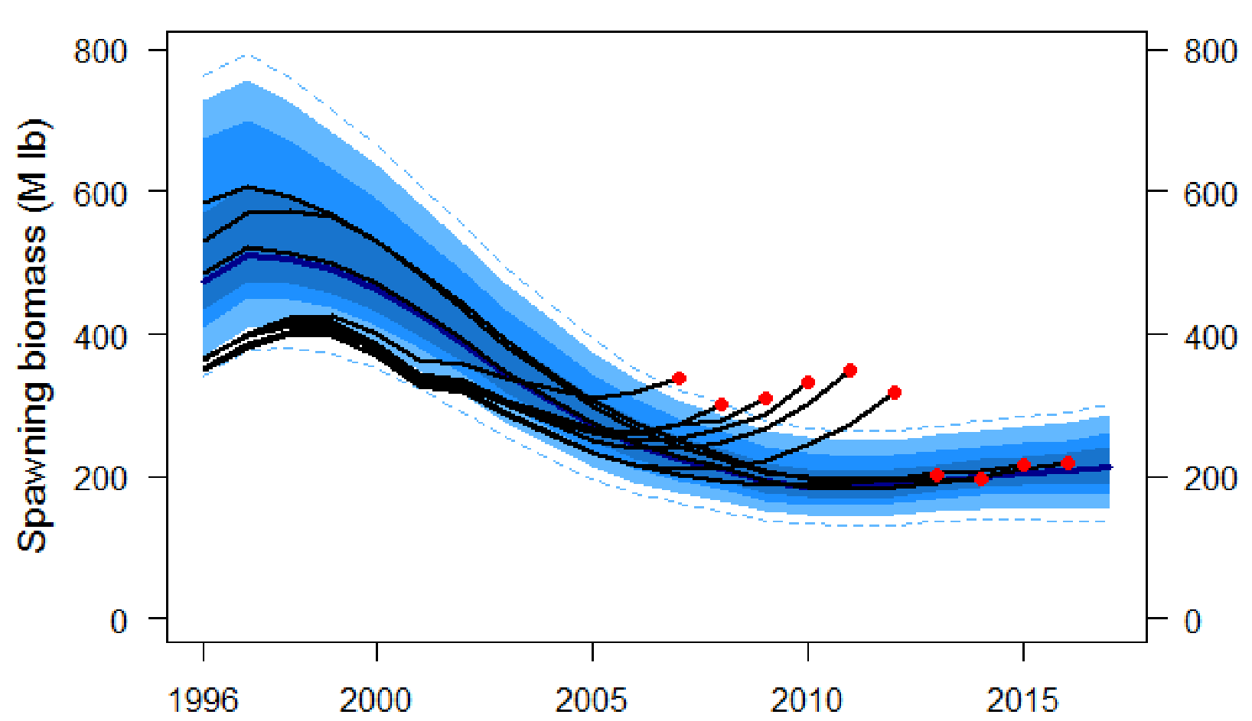
Annual Stock assessment for halibut performed by IPHC

Slide 53
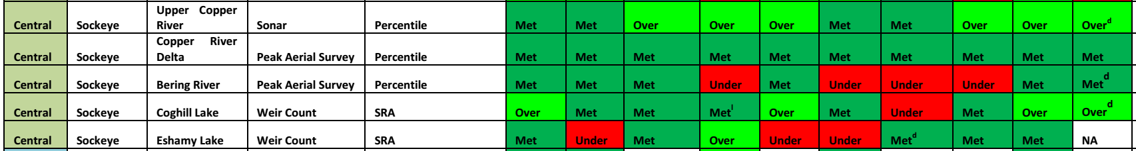
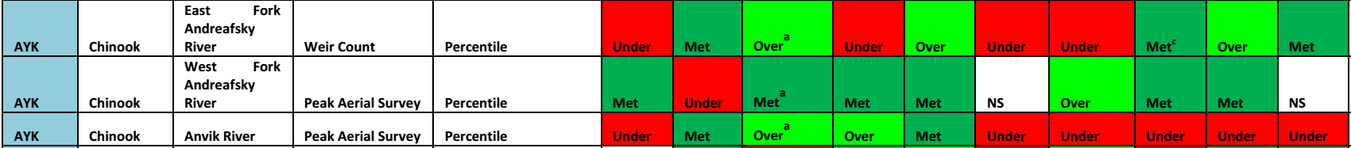
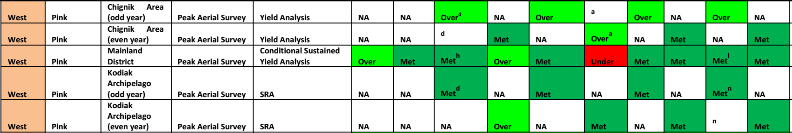
Annual Stock assessment for salmon performed by ADFG. Underperforming salmon stocks that do not meet their escapement goals (for 4-5 consecutive years) shall be appropriately managed within the Stock of Concern framework by the State of Alaska. If this is not the case, the current status/effectiveness EP is not met. Now part of scoring guidance.

Slide 54
8.5 Technical measures regarding the stock under consideration shall be taken into account, where appropriate, in relation to fish size, mesh size, gear, closed seasons or areas, areas reserved for particular (e.g., artisanal fisheries), and protection of juveniles or spawners.
Critical NC Score = 1 | Major NC Score = 4 | Minor NC Score = 7 | Full Conformance Score = 10
Lacking in three or more parameters | Lacking in two parameters | Lacking in one parameter | Fulfills all parameters
Evaluation Parameters Score Calculation Procedure: Each Evaluation Parameter has the same numerical value of 3. Meeting all parameters will result in a score of 10 (i.e., full conformance). Not meeting any 1 evaluation parameter will result in a score of 7 (i.e., minor non-conformance). Not meeting any 2 evaluation parameters will result in a score of 4 (i.e., major non-conformance). Not meeting any 3 or more evaluation parameters will result in a score of 1 (critical non-conformance). Process: The management system has taken into account technical measures, where and as appropriate (i.e., some fisheries do not have the requirement for a minimum fish size), to the fishery and stock under assessment, in relation to fish size, mesh size, gear, closed seasons, closed areas, areas reserved for particular (e.g., artisanal) fisheries, and protection of juveniles or spawners. Current Status/Appropriateness/Effectiveness: Technical measures are related to sustainability objectives, ensuring sustainable exploitation of the target stock, and minimizing the potential negative impacts of fishery activities on non-target species, ETP species, and the physical environment. Evidence Basis: The availability, quality, and/or adequacy of the evidence is sufficient to substantiate that technical measures regarding the stock under consideration are taken into account, where appropriate, in relation to fish size, mesh size, gear, closed seasons, closed areas, areas reserved for particular (e.g., artisanal) fisheries, and protection of juveniles or spawners. Examples may include fishery management plans, regulations or various other reports.

Slide 55

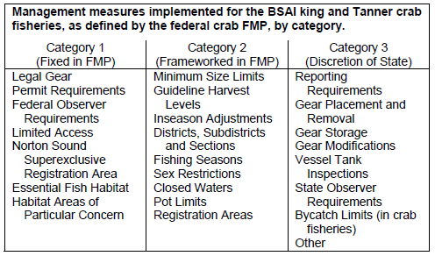
Title 5 of Fish and Game, Chapter 34 and 35 of the Alaska Administrative Code (5 AAC 34 and 35) specify all State requirements (e.g. gear specs etc...)

Slide 56
10.1 Effective mechanisms shall be established for fisheries monitoring, surveillance, control, and enforcement measures including, where appropriate, observer programs, inspection schemes, and vessel monitoring systems, to ensure compliance with the conservation and management measures for the fishery in question. This could include relevant traditional, fisher, or community approaches, provided their performance could be objectively verified.
Critical NC Score = 1 | Major NC Score = 4 | Minor NC Score = 7 | Full Conformance Score = 10
Lacking in three or more parameters | Lacking in two parameters | Lacking in one parameter | Fulfills all parameters
Evaluation Parameters Score Calculation Procedure: Each Evaluation Parameter has the same numerical value of 3. Meeting all parameters will result in a score of 10 (i.e., full conformance). Not meeting any 1 evaluation parameter will result in a score of 7 (i.e., minor non-conformance). Not meeting any 2 evaluation parameters will result in a score of 4 (i.e., major non-conformance). Not meeting any 3 or more evaluation parameters will result in a score of 1 (critical non-conformance). Process: There are clear mechanisms established for fisheries monitoring, surveillance, control, and enforcement. Current Status/Appropriateness/Effectiveness: These mechanisms are effective, and include effective observer programs, inspection schemes, and vessel monitoring systems where appropriate for the type of fishery under assessment. Monitoring, surveillance, control, and enforcement mechanisms can be considered effective if they are sufficiently broad to cover the entirety of the unit of certification, there is evidence that rules and regulations are consistently enforced, and there is no evidence of frequent or widespread violation of fishery regulations. This could include relevant traditional, fisher, or community approaches, provided their performance could be objectively verified. With respect to fisheries on the high seas, the legal obligations of UNCLOS and UNFSA have particular relevance. Evidence of the performance of the legal framework can be derived from assessing conformance with requirements covering compliance and enforcement. Specifically, the assessment team shall document the general level/type of fisheries controls (e.g., number of boardings, reprimands) and the respective level of fisheries violations (e.g., %) on a yearly basis. Evidence Basis: The availability, quality, and/or adequacy of the evidence is sufficient to substantiate that effective mechanisms are established for fisheries monitoring, surveillance, control, and enforcement measures including, where appropriate, observer programs, inspection schemes, and vessel monitoring systems, to ensure compliance with the conservation and management measures for the fishery in question. This could include relevant traditional, fisher or community approaches, provided their performance could be objectively verified. Examples may include rules and regulations, enforcement reports.

Slide 57
Observer Program, VMS and inspection schemes.

Slide 58
12.6 The fishery management organization shall consider the most probable adverse impacts of the fishery under assessment on main associated species (Appendix 1, Part 3 and 7), by assessing and, where appropriate, addressing and or/correcting them, taking into account available scientific information and local knowledge. Accordingly, these catches (including discards) shall be monitored and shall not threaten these non-target stocks with serious risk of extinction, recruitment overfishing, or other impacts that are likely to be irreversible or very slowly reversible. If such impacts arise, effective remedial action shall be taken.
Critical NC Score = 1 | Major NC Score = 4 | Minor NC Score = 7 | Full Conformance Score = 10
Lacking in three or more parameters | Lacking in two parameters | Lacking in one parameter | Fulfills all parameters
Evaluation Parameters Score Calculation Procedure: Each Evaluation Parameter has the same numerical value of 3. Meeting all parameters will result in a score of 10 (i.e., full conformance). Not meeting any 1 evaluation parameter will result in a score of 7 (i.e., minor non-conformance). Not meeting any 2 evaluation parameters will result in a score of 4 (i.e., major non-conformance). Not meeting any 3 or more evaluation parameters will result in a score of 1 (critical non-conformance). Process: There is a process that accounts for the most probable adverse impacts of the fishery under assessment on main associated species. This may take the form of an immediate management response or a further analysis of the identified risk. In the absence of specific information on such impacts of fishing for the unit of certification, generic evidence based on similar fishery situations can be used for fisheries with low risk of severe adverse impact. However, the greater the risk, the more specific evidence shall be necessary to ascertain the adequacy of mitigation measures. If information has been utilized from generic evidence based on similar fishery situations, then, based on the risk of severe adverse impact, the information shall be of higher precision for higher risk. For example, any of the following elements can be considered high risk for a fishery: keystone species, species with relative low growth rates or high catchability, fisheries with significant ETP or bycatch of non-target fishery resources (or non-target stocks, species, harvests, or discards), or fisheries with important concerns for gear–habitat interactions. If information specific to the unit of certification area is available, generic evidence based on similar fishery situations may not be necessary. Current Status/Appropriateness/Effectiveness: There is evidence that the fishery management organization considers the most probable adverse impacts of the fishery under assessment on main associated species (e.g. recruitment overfishing or other impacts that are likely to be irreversible or very slowly reversible), by assessing and, where appropriate, addressing and or/correcting them, taking into account available scientific information and local knowledge. Accordingly, these catches (including discards) are monitored and do not threaten these non-target stocks with serious risk of extinction, recruitment overfishing, or other impacts that are likely to be irreversible or very slowly reversible. If such impacts arise, effective remedial action are taken. Reversibility refers to the effects of a process or condition capable of being reversed so that the previous state is restored. Evidence Basis: The availability, quality, and/or adequacy of the evidence is sufficient to substantiate that the fishery management organization considers the most probable adverse impacts of the fishery under assessment on main associated species, by assessing and, where appropriate, addressing and or/correcting them, taking into account available scientific information and local knowledge. Accordingly, these catches (including discards) are monitored and do not threaten these non-target stocks with serious risk of extinction, recruitment overfishing, or other impacts that are likely to be irreversible or very slowly reversible. If such impacts arise, effective remedial action are taken. Examples may include various stock and ecosystems assessment reports.

Slide 59

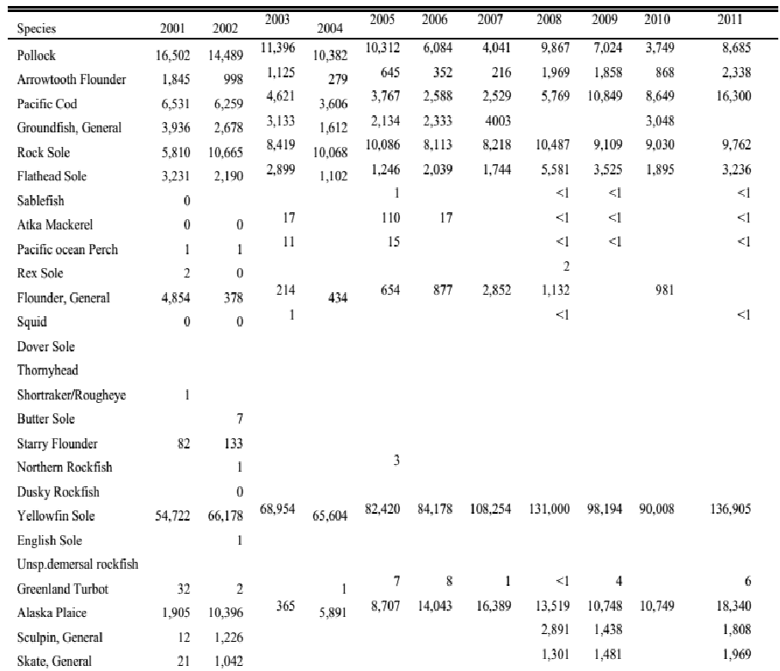
This is the bycatch profile for the BSAI yellowfin sole fishery.
Are the catches of stocks other then the stock under consideration monitored?
Is any of them at risk of overfishing?

Slide 60
Questions?

Slide 61
Unique Updates from Version 2

Slide 62
Important new clauses in V2.0
Clauses in Section 12 (Ecosystem Effects of Fisheries) have been re-structured to better clarify the assessment of:
Main Associated (bycatch) Species,
Minor Associated (bycatch) Species,
ETP species interactions
Habitat interactions
Ecosystem interactions
Other human impacts

Slide 63
Associated Species Assessment
The RFM Standard (V2.0) classifies bycatch as major and minor associated species catch.
The "Main" and "Minor" bycatch classification together makes up 95% of the associated species bycatch profile of a given target fishery.
The top 95% is assessed, while the bottom 5% is not assessed.
Of the 95% assessed, the top 80% is classified as Main Associated Species Catch, while the bottom 15% is classified as Minor Associated Species Catch.

Slide 64
Associated + ETP Species Assessment Diagram
Associated Species (bycatch) and ETP interactions
Target Fishery Effects
Effects on Main Associated Species
Top 80% of target species catch by weight (3-5 years average)
Effects on Minor Associated Species
Remaining 15% of target species catch by weight (3-5 years average)
Effects on ETP Species
All ETP species affected by the fishery are assessed

Slide 65
12.2 A (not for scoring) Summary Clause
Note: Clause 12.2 is a summary clause and as such does not need to be scored. The 12.2 sub-clauses will instead provide the specific elements that need to be scored.
The most probable adverse impacts from human activities, including fishery effects on the ecosystem/environment shall be assessed and, where appropriate, addressed and or/corrected, taking into account available scientific information and local knowledge. This may take the form of an immediate management response or a further analysis of the identified risk. In this context, full consideration should be given to the special circumstances and requirements in developing fisheries, including financial and technical assistance, technology transfer, training, and scientific cooperation. In the absence of specific information on the ecosystem impacts of fishing on the unit of certification, generic evidence based on similar fishery situations can be used for fisheries with low risk of severe adverse impact. However, the greater the risk, the more specific evidence shall be necessary to ascertain the adequacy of mitigation measures.

Slide 66
12.2.1 – Assess Main Associated Species
12.2.1 The fishery management organization shall consider the most probable adverse impacts of the fishery under assessment on main associated species (Appendix 1, Part 3 and 7), by assessing and, where appropriate, addressing and or/correcting them, taking into account available scientific information and local knowledge. Accordingly, these catches (including discards) shall be monitored and shall not threaten these non-target stocks with serious risk of extinction, recruitment overfishing, or other impacts that are likely to be irreversible or very slowly reversible. If such impacts arise, effective remedial action shall be taken.
Main Associated Species = 80% of total associated catch by weight

Slide 67
12.2.2 – Assess Minor Associated Species
12.2.2 The fishery management organization shall consider the most probable adverse impacts of the fishery under assessment on minor associated species (Appendix 1, Part 3 and 7), by assessing and, where appropriate, addressing and or/correcting them, taking into account available scientific information and local knowledge. Accordingly, these catches (including discards) shall be monitored and shall not threaten these non-target stocks with serious risk of extinction, recruitment overfishing, or other impacts that are likely to be irreversible or very slowly reversible. If such impacts arise, effective remedial action shall be taken.
Minor Associated Species = 15% of total associated catch by weight

Slide 68
12.2.4 – Assess ETP Species
12.2.4 The fishery management organization shall consider the most probable adverse impacts of the fishery under assessment on Endangered, Threatened, Protected (ETP) species (Appendix 1, Part 4 and 7), by assessing and, where appropriate, addressing and or/correcting them, taking into account available scientific information and local knowledge.

Slide 69
ETP Species Metrics
ETP Species must be acknowledged as such and recognized by national legislation adopted at the State and Federal level, or when recognized through a binding International Agreement.
Alternatively species listed under Appendix 1 of the Convention on International Trade in Endangered Species (CITES) or under the IUCN Redlist and impacted negatively by the fishery (i.e. direct or indirect mortality) shall be assessed as ETP unless it can be proven that their status in Alaska waters is above the point where recruitment is impaired or where other similar proxies indicate that the species is not biologically depleted.

Slide 70
ETP Species scoring
Scoring
To be considered effective, the assessment of ETP species within the RFM scheme has to ensure that a full score is assigned to those cases where ETPs are managed coherently starting from the policy/plan level (i.e. legally recognized as ETPs, formal and agreed management plans and measures) and subsequently towards implementation and effectiveness of the management measures in achieving the objectives of the plan agreed for management of these species.

Slide 71
Questions?

Slide 72
V2.0 Components:
RFM Metrics and Thresholds
V2.0 Components:
RFM Metrics and Thresholds
V2.0 Components:
RFM Metrics and Thresholds

Slide 73
RFM Metrics and Thresholds
Metrics in the V2 standard mirror the effective thresholds, reference point and indicators used in fisheries management (for groundfish, halibut, BSAI crab & salmon).
Metrics are available for the following areas:
Reference Points/Overfishing Definitions
Harvest Control Rules
Bycatch
ETP Species
Habitat
Ecosystem

Slide 74
Reference Points - Groundfish
Federally managed groundfish stocks such as sablefish, pollock, Pacific cod, flatfish and rockfish, managed under the BSAI and GOA FMPS, tier 3 and above will be assessed based on the following threshold indicators.
Target Reference point: B35/B40. 35% or 40% of unfished biomass levels
Limit Reference point: ½ MSY or B17.5. 17.5% of unfished biomass levels
See proxies for Tier 4, 5 and 6 in scoring guidance document.

Slide 75
Overfishing Definitions - Groundfish
Overfishing def.: Overfishing is defined as any rate of fishing in excess of the maximum fishing mortality threshold (MFMT), also called the “OFL control rule”.
Overfished def.: A stock is overfished when it falls below its MSST, defined as whichever of the following is greater: ½ the MSY stock size, or the minimum stock size threshold (MSST) at which rebuilding to the MSY level would be expected to occur within 10 years if the stock were exploited at the MFMT.
See proxies for Tier 4, 5 and 6 in main document.

Slide 76
Reference Points – P. Halibut
Pacific Halibut in Alaska will be assessed based on the following threshold indicators.
The target reference point is defined as 30% (B30 threshold level) of a level defined as the unfished level.
The limit reference point is defined as 20% (B20 limit level) of this estimated unfished level.

Slide 77
Reference Points/Overfishing Definitions – BSAI Crab
For BSAI crab stocks, the overfishing level (OFL) equals maximum sustainable yield (MSY).
For stocks where MSST (or proxies) are defined, if the biomass drops below the MSST (or proxy thereof) then the stock is considered to be overfished. MSSTs or proxies are set for stocks in Tiers 1-4.
For stock in Tier 1 and 2, the biomass that is associated with MSY, Bmsy, shall effectively treated as the target reference point. The (lower) limit reference point corresponds to ½ MSY.
For Tier 3 stocks, the target reference point B_{MSY} proxy is is B35% (when spawning biomass is reduced to 35% of the unfished condition).
See proxies for Tier 4, 5 in main document.

Slide 78
Overfishing Definitions – Salmon
For salmon fisheries in Alaska, overfishing or overfished definitions have been considered impractical and loosely applicable, partly because the multitude of salmon stocks are managed for escapements rather than for potential catch opportunities (e.g. TAC) identified through a prior assessment of abundance.
The following guidance has been provided, mirroring the State of Alaska Stocks of Concern management model

Slide 79
Overfishing Definitions – Salmon
Salmon stock does not meet escapement for 4-5 years period..
Placed under stock of concern designation affording specific management.
Considered responsible measure.
Not placed under stock of concern designation and NO valid explanation for why that is the case.
Classified as subject to “unsustainable practices leading to overfishing and overfished conditions”.

Slide 80
Harvest Control Rules
Harvest control rules are defined for:
Groundfish species,
BSAI crab species,
Pacific Halibut.
Salmon’s HCR ties in with the overfishing definition and other aspects of salmon management.
These HCRs follow Alaska’s management prescribed tier systems and HCRs.
See main document for details.

Slide 81
Habitat metrics
The effects of fisheries on sensitive habitats shall be reduced to a minimum percentage of the total area. Assessment teams shall:
Identify the spatial footprint (i.e. total area in Km² or nm²) of the fishery on marine habitats (e.g. based on maps of fishing fleet distribution or other data).
Identify the general range of habitat type/substrate (e.g. sand, muddy, gravel and pebble, rocky reefs, kelp, other biogenic habitats) affected and unaffected by the spatial footprint of the fishery.
Assess the percentage area of overlap of the fishery with known sensitive habitats using available data. Sensitive habitats include HAPCs, other areas of known distribution rich in structural epifauna, areas of particular importance for ETP species, and closed areas which may be set up for habitat, species conservation or both.

Slide 82
Habitat metrics - continued
If the fishery is having a significant negative effect on sensitive habitats, the assessment team shall take into account:
the degree of disturbance (% of total sensitive area overlapping with fishery),
the sensitivity of the habitat (e.g. habitat susceptible or encounterable/ accessible by fishing gear; exposed to routine, occasional, little or no fishing disturbance or natural perturbation) and,
the projected recovery rate of such habitats (e.g. fast, medium, slow) in the presence and absence of fishing. Furthermore, management measures shall be in place (e.g. at the federal or State level) to minimize/mitigate these effects.

Slide 83
Habitat metrics - continued
Assess and estimate the effects of the fishery footprint on non biogenic, low physical complexity or low sensitivity habitats (e.g. mud, sand, pebble/cobble), where the habitat is not considered to be significantly affected by bottom impact gear or where the recovery rate of these habitats is believed to be fast.
Evaluate whether the effects on this class of habitats are considered significant. For example, Essential Fish Habitats are generally considered to include the general distribution of the species for particular life stage. If the species is at target levels in terms of stock status and fishing mortality, then it can be inferred that the effects on the EFH for the species are likely not significant.

Slide 84
Habitat metrics - scoring
Scoring guidance:
Based on an evaluation of the previous indicators the fishery can be scored based on available data and expert opinion as follow:
Qualitative score description | Score
There is a high likelihood that the unit of certification is not causing significant, non-reversible harm on essential habitats for the stock under consideration and on habitats that are highly vulnerable to damage by the fishing gear of the unit of certification. | Full Conformance
There is a small likelihood that the unit of certification is causing significant, non-reversible harm on essential habitats for the stock under consideration and on habitats that are highly vulnerable to damage by the fishing gear of the unit of certification. | Minor Non-Conformance
There is a moderate likelihood that the unit of certification is causing significant, non-reversible harm on essential habitats for the stock under consideration and on habitats that are highly vulnerable to damage by the fishing gear of the unit of certification. | Major Non-conformance
There is a high likelihood that the unit of certification is causing significant, non-reversible harm on essential habitats for the stock under consideration and on habitats that are highly vulnerable to damage by the fishing gear of the unit of certification. | Critical Non-conformance

Slide 85
Cumulative Effects of Fisheries
Main Associated Species
Assess ALL fisheries in the region.
ETP Species
ETP species acknowledged and recognized by national legislation, or through binding International Agreement (or through CITES, IUCN).
Ensure all major removals are accounted for.
Management measures are effective at avoiding species from experiencing overfishing and other impacts that are likely to be irreversible or very slowly reversible.
Assess ALL fisheries in the region.
Assess the policy/plan level (i.e., legally recognized as ETPs, formal and agreed management plans/measures).
Verify implementation and effectiveness of the management measures in line with agreed objectives.
Habitats
Assess ALL CERTIFIED fisheries in the region.
Ensure that effects of fishing on sensitive habitats are assessed.
Verify that management measures are effective in protecting sensitive habitats, maintaining the footprint from increasing, and allowing for the recovery of such habitats, where appropriate, through area closures or other effective measures.

Slide 86
Ecosystem Metrics
Assessment Team shall assess the contribution of the fishery under consideration to bycatch of 1) prohibited species, 2) Habitat Areas of Particular Concern (HAPC) biota, 3) marine mammals and birds, and 4) other sensitive non-target species.
Accordingly, the fishery shall not have significant effects on the groups specified. Each of these groups shall be managed accordingly (in a coherent and effective way) by the relevant authorities and removals shall be monitored to ensure the totality of these groups is not been significantly affected by the fishery (e.g. by excessive removals).
Indices of abundance of HAPC biota, key affected prohibited species, key affected marine mammals and birds, and other sensitive non target species, as appropriate can be useful to assess this element.

Slide 87
Ecosystem Metrics - continued
The fishery shall be sufficiently dispersed in space and time relative to important predators needs (in space and time if known) and relative to important spawning components, to avoid localized depletions with potential effects on dependant species.
Equally importantly, there shall be a limited spatial and temporal concentration of fishery impacts on important forage fish. Indexes of fishing distribution and of forage fish abundance can be useful to asses this element.
The fishery-specific contribution to discards and offal production shall be assessed and the fishery shall be managed coherently and effectively to reduce waste and minimize potential long-term changes in ecosystem biomass, respiration, production, or energy cycling that are outside the range of natural variability.

Slide 88
Ecosystem Guidance - continued
Scoring Guidance for Ecosystem
Based on an evaluation of the indicators previously presented the fishery can be scored based on available data and expert opinion as follow:
Qualitative score description | Score
There is a high likelihood that the unit of certification, including any enhancement activities, is not causing adverse impacts on the structure, processes and function of aquatic ecosystems that are likely to be irreversible or very slowly reversible. | Full conformance
There is a small likelihood that the unit of certification, including any enhancement activities, is causing adverse impacts on the structure, processes and function of aquatic ecosystems that are likely to be irreversible or very slowly reversible. | Minor non Conformance
There is a moderate likelihood that the unit of certification, including any enhancement activities, is causing adverse impacts on the structure, processes and function of aquatic ecosystems that are likely to be irreversible or very slowly reversible. | Major non conformance
There is a high likelihood that the unit of certification, including any enhancement activities, is causing adverse impacts on the structure, processes and function of aquatic ecosystems that are likely to be irreversible or very slowly reversible. | Critical non conformance

Slide 89
Questions?

Slide 90
Now you try score a few clauses..

Slide 91
Critical NC Score = 1 | Major NC Score = 4 | Minor NC Score = 7 | Full Conformance Score = 10
Lacking in three or more parameters | Lacking in two parameters | Lacking in one parameter | Fulfills all parameters
Evaluation Parameters Process: Describe how fishery-related information is disseminated and the process in place to consult with fishery sector and fishing communities. Current Status/Appropriateness/Effectiveness: There are records of consultations with fishing communities and the fisheries sector. Attempts have been made to create public awareness on the need for protection and management of coastal resources, and those affected by the management process have been made aware of its provision. Evidence Basis: The availability, quality, and/or adequacy of the evidence is sufficient to substantiate that representatives of the fisheries sector and fishing communities are consulted in the decision-making processes involved in other activities related to coastal area management planning and development. The public, and others affected, are also kept aware of the need for the protection and management of coastal resources, and are participants in the management process. Examples may include public records of consultation activities and other available documentation published on the internet or distributed at public meetings.
Evidence: Key representatives of the fisheries sector are consulted in decision making, through public meeting engagement and attendance. All meetings are public and all decisions, and discussion papers are published online.
What is your score?

Slide 92
Critical NC Score = 1 | Major NC Score = 4 | Minor NC Score = 7 | Full Conformance Score = 10
Lacking in three or more parameters | Lacking in two parameters | Lacking in one parameter | Fulfills all parameters
Evaluation Parameters Process: A target reference point(s) or proxy has been officially established. Managers shall be able to apply technical measures to reduce fishing pressure in the event that reference points are approached or exceeded. Current Status/Appropriateness/Effectiveness: The official target reference point or proxy is consistent with achieving maximum sustainable yield (MSY), a suitable proxy, or a lesser fishing mortality—if that is optimal in the circumstances of the fishery (e.g., multispecies fisheries) or is needed to avoid severe adverse impacts on dependent predators (e.g. recruitment overfishing or other impacts that are likely to be irreversible or very slowly reversible). Reversibility refers to the effects of a process or condition capable of being reversed so that the previous state is restored. Furthermore, there is evidence that the target reference point/management target has been used as an objective by the management process. If there are historical instances of the reference point being approached or exceeded, managers have taken remedial action as appropriate. In the context of reference points, when data are insufficient to estimate reference points directly, other measures of productive capacity can serve as reasonable substitutes or proxies. Suitable proxies may include, for example, standardized CPUE as a proxy for biomass; or specific levels of fishing mortality and biomass which have proven useful in other fisheries can be used with a reasonable degree of confidence in the absence of better defined levels. It is important to note that the use of a proxy may involve additional uncertainty, and if so, should trigger extra precaution in setting biological reference points. For salmon, escapement goals are the equivalent of a target reference point proxy (i.e., the upper threshold of the escapement goal). Evidence Basis: The availability, quality, and/or adequacy of the evidence is sufficient to substantiate that target reference points have been established and are consistent with achieving maximum sustainable yield (MSY), a suitable proxy, or a lesser fishing mortality—if that is optimal in the circumstances of the fishery (e.g., multispecies fisheries) or is needed to avoid severe adverse impacts on dependent predators. Examples may include stock assessment reports or fishery management plans.
Evidence: Proxy reference point is formally established in FMP. It is based on long term average catch * 0.75 to establish MSY equivalent (i.e. OFL). Managers have never exceeded OFL. Evidence basis is very clear.
What is your score?

Slide 93
Critical NC Score = 1 | Major NC Score = 4 | Minor NC Score = 7 | Full Conformance Score = 10
Lacking in three or more parameters | Lacking in two parameters | Lacking in one parameter | Fulfills all parameters
Evaluation Parameters Process: There is an agreed process, system, or contingency plan in the eventuality that the data sources and analyses indicate that these reference points have been exceeded—detailing the appropriate management response to serious threats to the resource as a result of overfishing, adverse environmental changes, or other phenomena adversely affecting the fishery resource. Accordingly, the contingency plan/harvest control rule shall be agreed in advance to allow an appropriate management response to serious threats to the resource as a result of overfishing, adverse environmental changes, or other phenomena adversely affecting the fishery resource. Current Status/Appropriateness/Effectiveness: In the eventuality that the current level of the stock has exceeded target or limit reference points, the agreed and corresponding management action (as directed by the harvest control rule or framework) shall be immediately implemented and fishing reduced or halted as necessary. The harvest control rule is effective at keeping or bringing back the stock to acceptable and safe biological levels (i.e., to avoid overfishing/ed status). Underperforming salmon stocks that do not meet their escapement goals shall be appropriately managed within the stock of concern framework by the State of Alaska. Evidence Basis: The availability, quality, and/or adequacy of the evidence is sufficient to substantiate that management actions are agreed should data sources and analyses indicate that these reference points have been exceeded. Accordingly, contingency plans are agreed in advance for the appropriate management response to serious threats to the resource as a result of overfishing, adverse environmental changes, or other phenomena adversely affecting the fishery resource. Such measures may be temporary and are based on best scientific evidence available. Examples may include stock assessment reports or fishery management plans.
Evidence: There is an established harvest control rule in FMP including rebuilding strategy. The stock is very close to limit RP but management declared they will take measures not before 12 months from now. Stock assessment information is present and is currently the best available information on stock.
What is your score?

Slide 94
Critical NC Score = 1 | Major NC Score = 4 | Minor NC Score = 7 | Full Conformance Score = 10
Lacking in three or more parameters | Lacking in two parameters | Lacking in one parameter | Fulfills all parameters
Evaluation Parameters Process: The management system has taken into account technical measures, where and as appropriate (i.e., some fisheries do not have the requirement for a minimum fish size), to the fishery and stock under assessment, in relation to fish size, mesh size, gear, closed seasons, closed areas, areas reserved for particular (e.g., artisanal) fisheries, and protection of juveniles or spawners. Current Status/Appropriateness/Effectiveness: Technical measures are related to sustainability objectives, ensuring sustainable exploitation of the target stock, and minimizing the potential negative impacts of fishery activities on non-target species, ETP species, and the physical environment. Evidence Basis: The availability, quality, and/or adequacy of the evidence is sufficient to substantiate that technical measures regarding the stock under consideration are taken into account, where appropriate, in relation to fish size, mesh size, gear, closed seasons, closed areas, areas reserved for particular (e.g., artisanal) fisheries, and protection of juveniles or spawners. Examples may include fishery management plans, regulations or various other reports.
Evidence: All technical measures mentioned taken into account apart from fish size. Latest assessment indicates that target stock status has dropped between target and limit ref. point, probably because localised area depletion. Catch information by gear and geographical area is available.
What is your score?

Slide 95
Critical NC Score = 1 | Major NC Score = 4 | Minor NC Score = 7 | Full Conformance Score = 10
Lacking in three or more parameters | Lacking in two parameters | Lacking in one parameter | Fulfills all parameters
Evaluation Parameters Process: There is a process that accounts for the most probable adverse impacts of the fishery under assessment on minor associated species. This may take the form of an immediate management response or a further analysis of the identified risk. In the absence of specific information on such impacts of fishing for the unit of certification, generic evidence based on similar fishery situations can be used for fisheries with low risk of severe adverse impact. However, the greater the risk the more specific evidence shall be necessary to ascertain the adequacy of mitigation measures. If information has been utilized from generic evidence based on similar fishery situations, then, based on the risk of severe adverse impact, the information shall be of higher precision for higher risk. For example, any of the following elements can be considered high risk for a fishery: keystone species, species with relative low growth rates or high catchability, fisheries with significant ETP or bycatch of non-target fishery resources (or non-target stocks, species, harvests, or discards), or fisheries with important concerns for gear–habitat interactions. If information specific to the unit of certification area is available, generic evidence based on similar fishery situations may not be necessary. Current Status/Appropriateness/Effectiveness: There is evidence that the fishery management organization considers the most probable adverse impacts of the fishery under assessment on minor associated species, by assessing and, where appropriate, addressing and or/correcting them, taking into account available scientific information and local knowledge. Accordingly, these catches (including discards) are monitored and do not threaten these non-target stocks with serious risk of extinction, recruitment overfishing, or other impacts that are likely to be irreversible or very slowly reversible. If such impacts arise, effective remedial action are taken. Reversibility refers to the effects of a process or condition capable of being reversed so that the previous state is restored. Evidence Basis: The availability, quality, and/or adequacy of the evidence is sufficient to substantiate that the fishery management organization considers the most probable adverse impacts of the fishery under assessment on minor associated species, by assessing and, where appropriate, addressing and or/correcting them, taking into account available scientific information and local knowledge. Examples may include various stock and ecosystems assessment reports.
Evidence: There is clear accounting for associated species and bycatch, including management measures for most commercial species (i.e. TACs and other catch restriction measures). However, limited stock abundance data is available for 2 out of 30 species and CPUE trends are unclear.
What is your score?

Slide 96
Critical NC Score = 1 | Major NC Score = 4 | Minor NC Score = 7 | Full Conformance Score = 10
Lacking in three or more parameters | Lacking in two parameters | Lacking in one parameter | Fulfills all parameters
Evaluation Parameters Process: There is a process that accounts for the most probable adverse impacts of the fishery under assessment on habitats. This may take the form of an immediate management response or a further analysis of the identified risk. In the absence of specific information on such impacts of fishing for the unit of certification, generic evidence based on similar fishery situations can be used for fisheries with low risk of severe adverse impact. However, the greater the risk the more specific evidence shall be necessary to ascertain the adequacy of mitigation measures. If information has been utilized from generic evidence based on similar fishery situations, based on the risk of severe adverse impact, the information shall be of higher precision for higher risk. For example, any of the following elements can be considered high risk for a fishery: keystone species, species with relative low growth rates or high catchability, fisheries with significant ETP or bycatch of non-target fishery resources (or non-target stocks, species, harvests, or discards), or fisheries with important concerns for gear–habitat interactions. If information specific to the unit of certification area is available, generic evidence based on similar fishery situations may not be necessary. Current Status/Appropriateness/Effectiveness: There is evidence that the fishery management organization considers the most probable adverse impacts of the fishery under assessment on habitats, by assessing and, where appropriate, addressing and or/correcting them, taking into account available scientific information and local knowledge. Accordingly, if these impacts are likely to be irreversible or very slowly reversible, effective remedial action is taken (please see Appendix 1 part 5, noting specifically the 3 habitat assessment elements, and part 7 for cumulative effects evaluation). Reversibility refers to the effects of a process or condition capable of being reversed so that the previous state is restored. Evidence Basis: The availability, quality, and/or adequacy of the evidence is sufficient to substantiate that the fishery management organization considers the most probable adverse impacts of the fishery under assessment on habitats, by assessing and, where appropriate, addressing and or/correcting them, taking into account available scientific information and local knowledge.
Evidence: This is a trawl fishery with a very large footprint that fishes on the Easter Bering Sea Canyons, where many corals, sponge and other sensitive biota are found. The Trawl fishery has raised bobbins that raise the bottom trawl from the sea floor.
What is your score?

Slide 97
Questions?

Slide 98
Data Deficient Framework

Slide 99
V2. Data Deficient Framework
DDF Uses the well known Productivity Susceptibility Analysis (PSA) when stock status information is missing. Uses the Patrick et al. version with most PS attributes (i.e. more precise).
The DDF was modified to reflect the changes from Version 1.3 to Version 2 of the standard
Updated from 3 to 4 clauses assessed in DDF
ETP species related clause also has changed

Slide 100
V1.3 vs V2. Data Deficient Framework
Assess Stock Status under Clause 6.3
Assess Associated Bycatch under Clause 12.6
Assess ETP Species under Clause 12.12
V1.3 DDF Clauses
V2.0 DDF Clauses
Assess Stock Status under Clause 6.3
Assess Main Associated Bycatch under Clause 12.2.1
Assess ETP Species under Clause 12.2.4
Assess Minor Associated Bycatch under Clause 12.2.2

Slide 101
What clauses are not assessed in the DDF?
Habitats and ecosystem elements (as well as al other clauses not mentioned in previous slide) are not assessed under this framework
It is believed that sufficient scientific information is available at the ecosystem and fishery level, to assess these indicators using the regular RFM clauses, for the majority of managed fisheries.

Slide 102
Thank you for your attention

